Slide 1
5 Modern Goal Setting

Slide 2


What are your Goals?
Notes:
What are your top 3 goals (eg at work) ? Are they simple – by when are you going to achieve them…?

Slide 3
There are no quick fixes

Slide 4


It can be frustrating

Slide 5

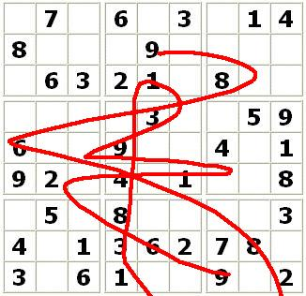
Occasionally, you will mess up!

Slide 6

And Finally…
Have fun!

