Slide 1
7 Understanding your customers

Slide 2
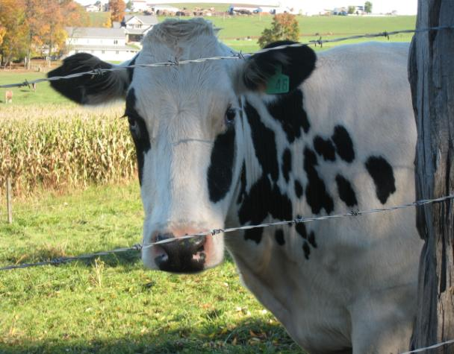
I suggest investing in magic beans.

Slide 3
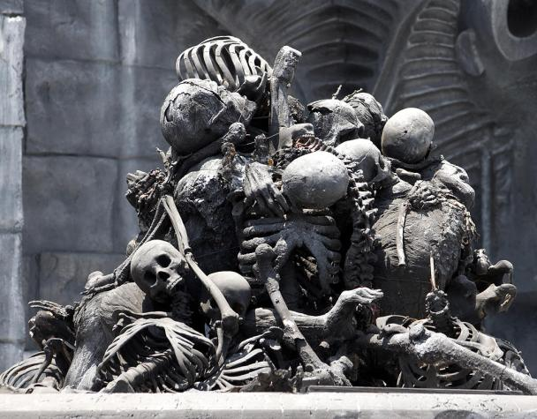
The corporate ladder.

Slide 4
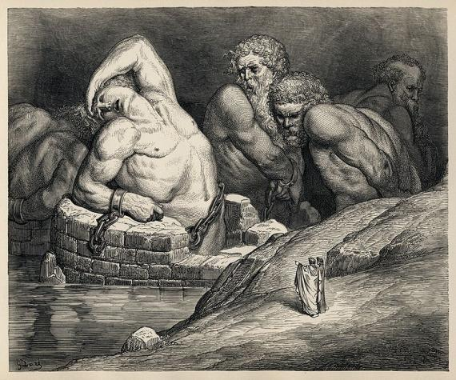
The Board, uhh, (what are they good for?), absolutely nothin’. Say it again now!

Slide 5
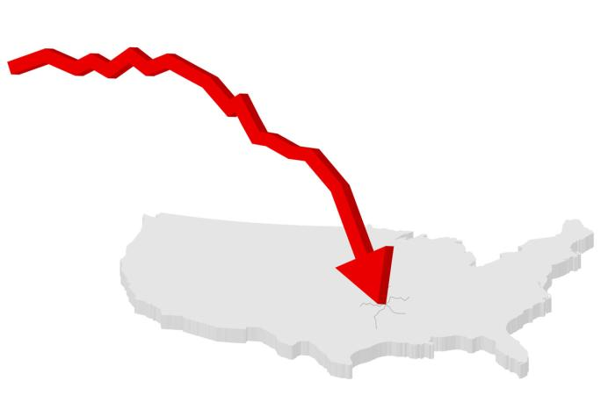
Weeeeee!

Slide 6
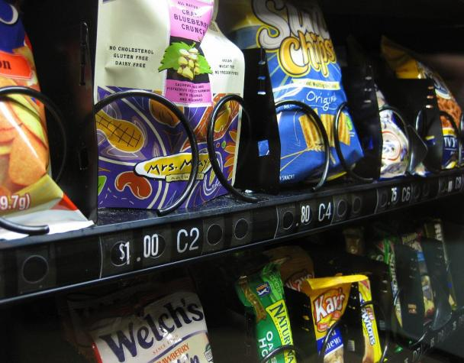
Consumers want easy transactions.
And saltiness.

